Slide 1
Survival of the Unit Rates, Fraction Ratios, and the Amazon Rainforest of course!

Slide 2
Vocabulary!
Unit Rate: a comparison of two measurements in which one of the terms has a value of 1

Slide 3
Unit Rates with Speed
Example: The top speed of a panther is 426 miles per 6 hours. How far does he run in 1 hour?
Step One: Set up the unit rate fraction.
426 miles
6 hours
Step Two: Divide & write your
answer as a unit rate.
71 miles per 1 hour
or 71 miles per hour

Slide 4
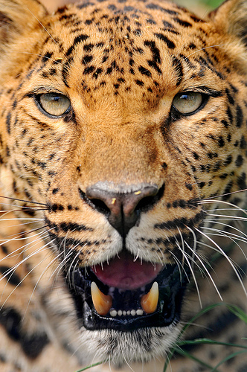
Fractions and Unit Rates with Speed
Example: The top speed of a jaguar is 150 miles per 3 hours. What is the unit rate (per hour)?
Step One: Set up the unit rate fraction.
Step Two: Divide and write your answer as a unit rate.
150 miles ÷ 3 hours
50 miles per hour

Slide 5
Unit Rates with Price
Example: Epibatidine is a strong pain killer developed from the skin of a poison dart frog. It sells for $215 in the USA for 10 oz. What is the unit rate (per oz)?
Step One: Set up the unit rate fraction.
$215
10 oz
Step Two: Divide & write your answer as a unit rate.
$21.50 per oz

