Slide 1
REVIEW FOR THE unit 2 Test
Ghosts in the graveyard

Slide 2
Instructions:
You will answer all the questions on the slide on your paper in 3-5 minutes.
You will discuss answers with your group.
The teacher will check one of the group members’ answers.
If that group member has all of the problems correct, the group will be instructed to place a ghost in the graveyard.
At the end of class, each headstone will get a multiplier.
Teams will total up their points.
The group with highest score will win!!

Slide 3
Here lies
HENRY HICCUP
R.I.P.
TIM TOM
$$×4$$
$$×−2$$
1970-2017
MARTA MAE
In Memory of
STEVE SPEED
$$×3$$
$$×0$$

Slide 4
SLIDE 1 Simplify the Expressions
5(2a - b) -3 (3a + 2b)
5 + 2 (4x - 4) – 6x
-9 (-2m + 3)
4 -2 (5a - 4) + 7a - 6

Slide 5
SLIDE 2 Solve the Equation
3 + 4x = -13
5(2n - 6) + 7 = 32
n + 7 = - 4 3
10 + 2m -12 + m = -26

Slide 6
SLIDE 3 Solve the Inequality
2x + 6 < -8
-3y – 4 ≥ -16
7 + h > -5 10

Slide 7
SLIDE 4 translate to an Equation
Six greater than three times m is negative five.
Eight less than the quotient of c and 3 equals twelve.
Seven added to the product of r and four is twenty-five.

Slide 8
SLIDE 5 Translate the Inequality and solve.
You are saving money for a new jacket that costs $90. You have $42 from your Uncle Ed, that he gave you for your birthday, and you can earn $5 per hour babysitting your little brother. Write and solve an inequality to show how many hours you must babysit to buy the jacket.

Slide 9
SLIDE 6 Translate the equation and solve.
The shirt that you bought costs $18. You also bought 2 pairs of shoes that were the same amount. Your total at the checkout was $59. How much did each pair of shoes cost?

Slide 10
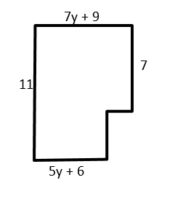
SLIDE 7 Find the perimeter of the figure

