Slide 1
Solving Problems with Linear Functions
Unit 8

Slide 2
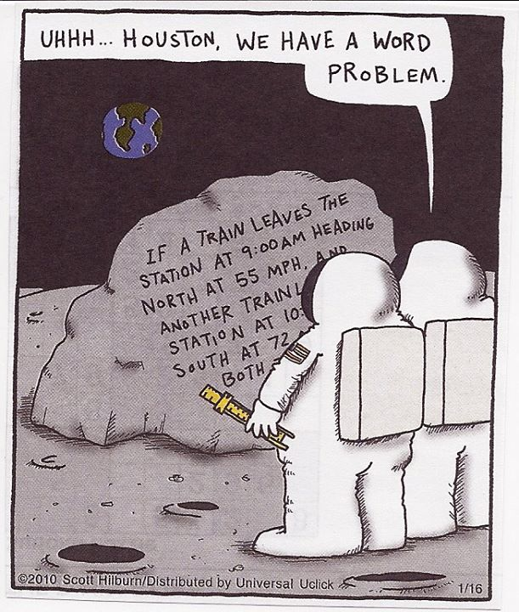
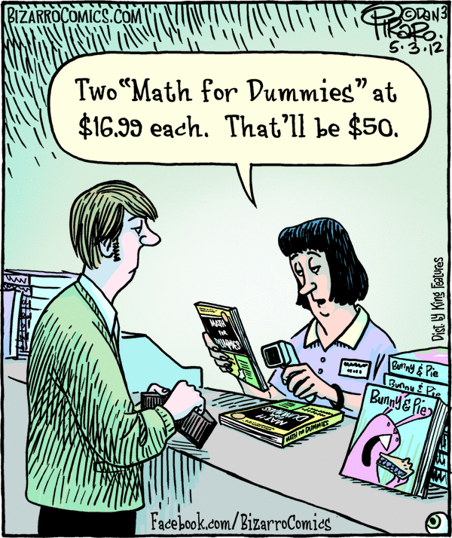

Slide 3
Step by Step- Solving Word Problems
Step 1: Read the problem carefully
Step 2: Underline WHAT you are solving for
Step 3: Draw a picture to visualize the words
Step 4: Assign variables to the quantities you are trying to find
Step 5: Define the variable

Slide 4
Step by Step- Solving Word Problems
Step 6: Re-read the problem and WRITE an equation for the quantities given
Step 7: Solve the equation
Step 8: Answer the question in the problem
Step 9: Check your solution.
Does your answer MAKE SENSE when you put it in context?

Slide 5
Has anyone noticed a connection between SLOPE and UNIT RATE?

Slide 6
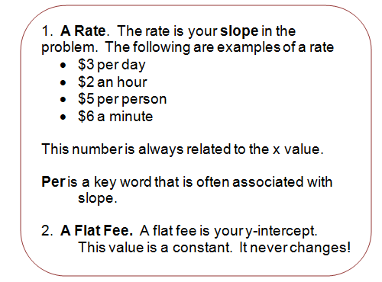
Tips: Translating Words into an Equation

Slide 7
Let’s Practice!
Derek started with no money in his bank account, but he just got a job mowing lawns and he gets $20 per week. He puts all of it in his account. How much money will he have in his account in x weeks?

Slide 8
Twitter allows for each user to create a tweet of 140 characters or less. Write an equation representing the amount of characters remaining and how many characters are used.

Slide 9
Jimmy has $88 in his piggy bank. He is saving his allowance of $15 per week and putting it in his piggy bank as well. Write an algebraic equation to represent this function.
Challenge: If Jimmy wants to buy a new video game system for $250, how many weeks allowance will he need to save?

Slide 10
Jamie needs to write a paper for class that is 2,000 words long. She can write 375 words per hour if the television is off. Write an algebraic equation to represent this function.
Challenge: How many hours will it take Jamie to write
her 2,000 word paper? (Round to nearest hour)

Slide 11
Katie has $120 on her cafeteria card. Every time she orders a meal, $4.50 is deducted from the value on her card. What is the equation for the amount of money she has on her card after eating x meals?
Challenge: How many meals has Katie ordered from the cafeteria if she has $70.50 left on her card?

Slide 12
John needs to take the Subway diet. He currently weighs 250 lbs. He creates a workout regimen that would help him lose 2.5 pounds per week. Write an algebraic equation that represents this function.
Challenge: How many weeks will John need to workout
before he weighs less than 200 lbs?

